Slide 1
Design Capstone II
Mathematics Review

Slide 2
Mathematics Content
Analytic Geometry & Trigonometry
Single-Variable Calculus
Differential Equations
Linear Algebra
Numerical Methods

Slide 3
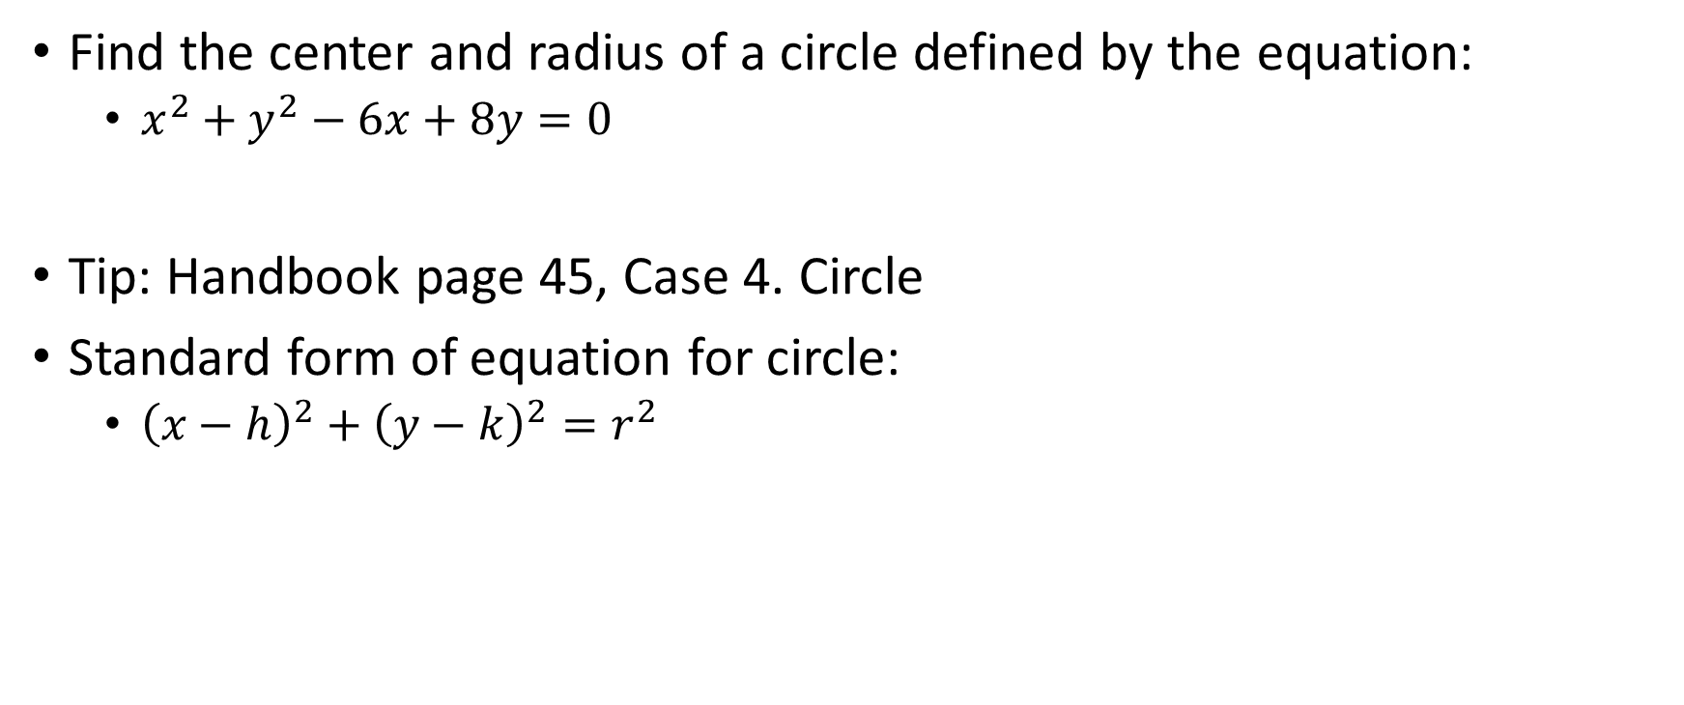
Analytic Geometry
Find the center and radius of a circle defined by the equation:
  $x^{2}+y^{2}−6x+8y=0$
Tip: Handbook page 45, Case 4. Circle
Standard form of equation for circle:
  ${\left(x−h\right)}^{2}+{\left(y−k\right)}^{2}=r^{2}$

Slide 4

Trigonometry
Simplify the following expression: $\frac{\cos^{2}{θ}\tan^{2}{θ}}{\sin{θ}}$

Slide 5

Single-Variable Calculus
Evaluate the following definite integral:
  $\int_{0}^{2}{\left(3x^{2}−4x+5\right)}dx$

Slide 6

Differential Equations
Identify the general solution for the first-order separable differential equation:
  $\frac{dy}{dx}=3x^{2}y$

Slide 7
Linear Algebra
Find the determinant of the following 3x3 matrix:
  A = [1 0 3
    3 -1 1
    2 0 4]
    Turn to page 59

Slide 8
Numerical Methods
Using the Newton-Raphson method with an initial guess of x0=2, find the first approximation (x1) for a root of f(x)=x^2-5=0

